Slide 1
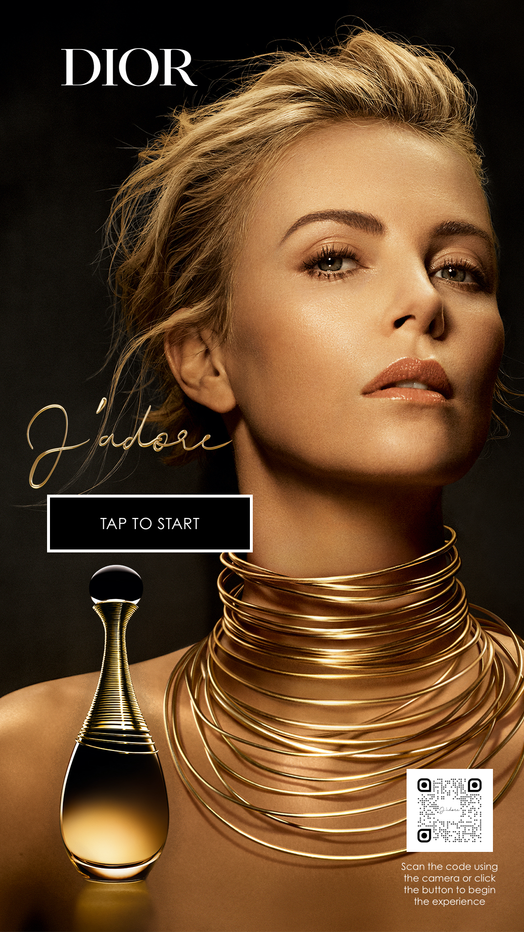
Dropbox folder with all assets:
Replace background with https://www.dropbox.com/s/c4srix9r06to0pu/Background%202.jpeg?dl=0
Delete logo
Delete perfume bottle

Slide 2
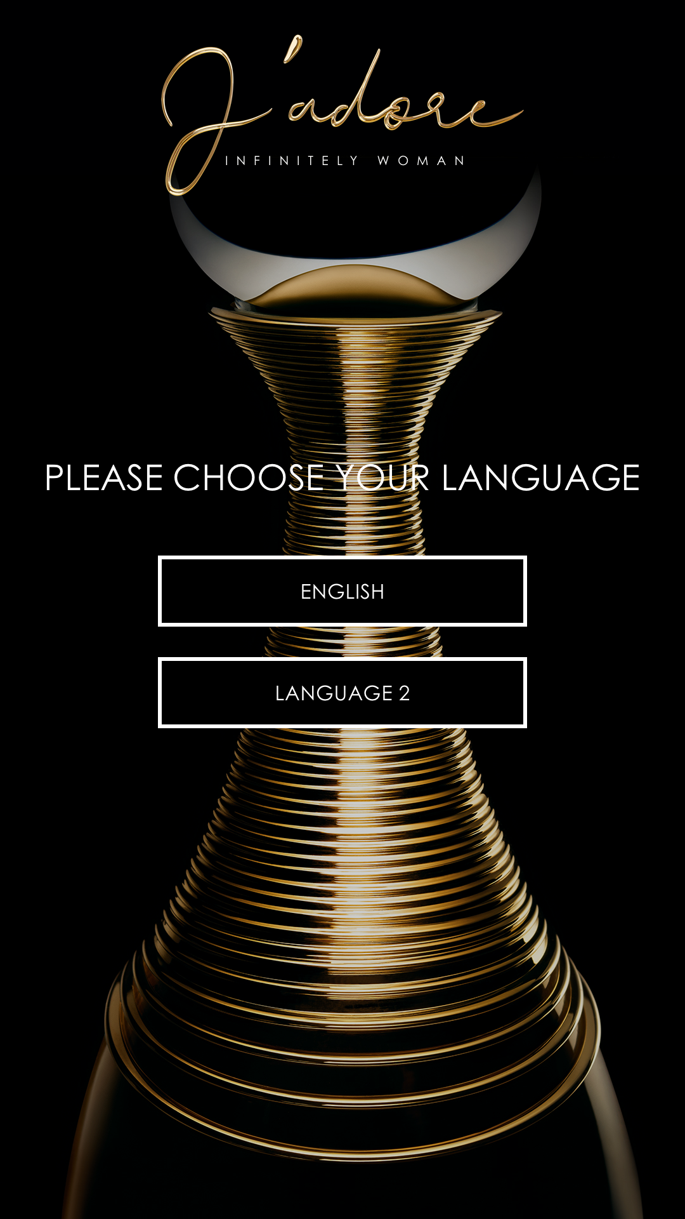
Delete logo
Replace background with https://www.dropbox.com/s/c4srix9r06to0pu/Background%202.jpeg?dl=0

Slide 3
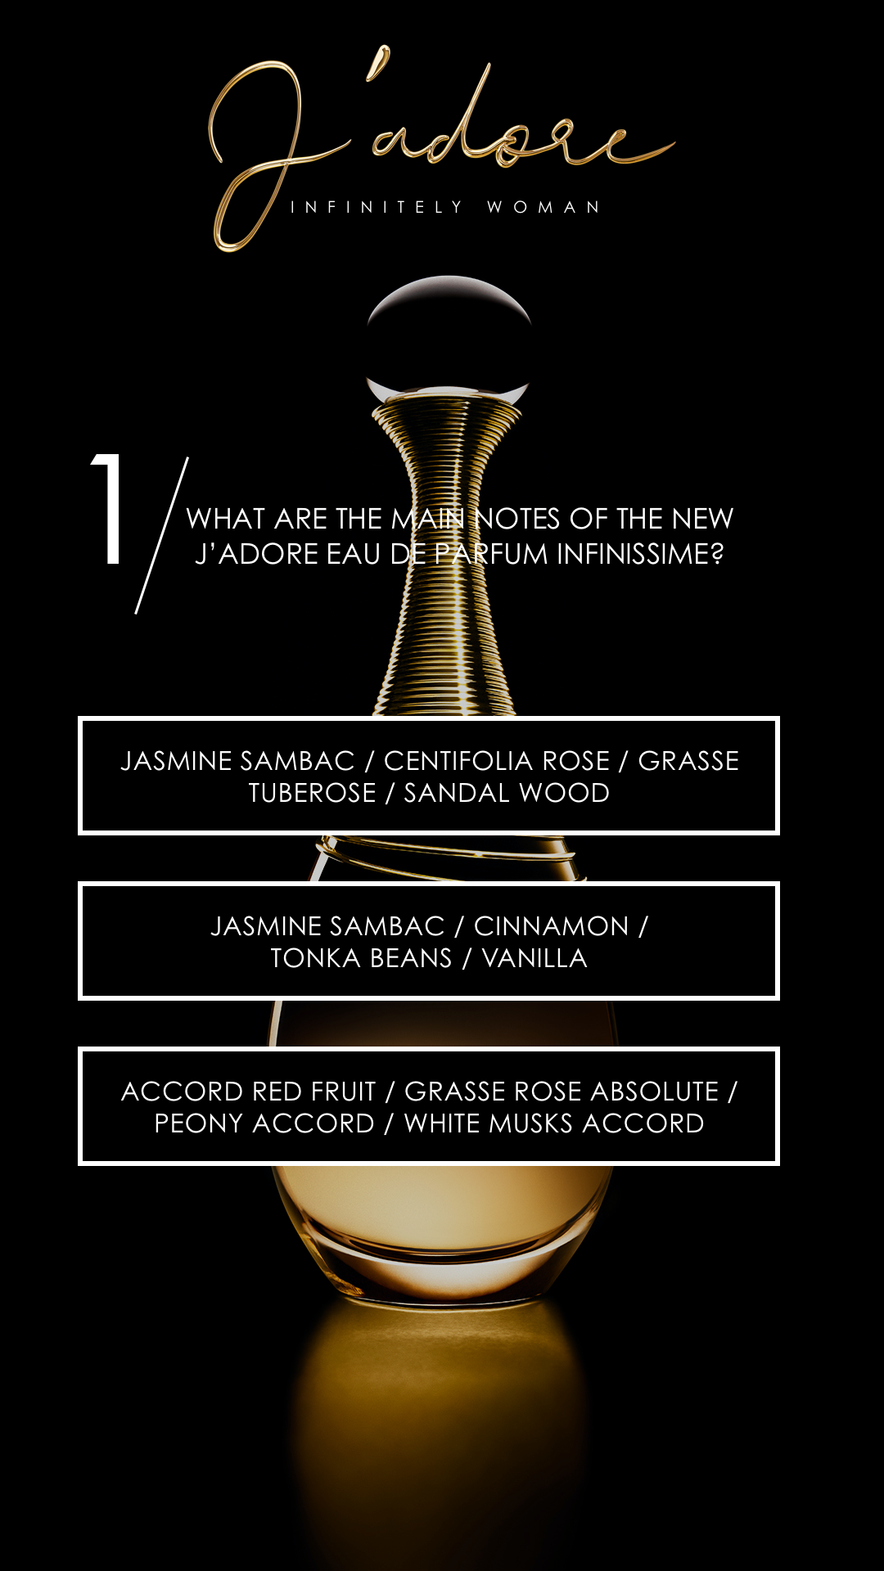
Delete logo
Replace background with https://www.dropbox.com/s/c4srix9r06to0pu/Background%202.jpeg?dl=0
Replace Question with:
When would you like to use this fragrance?
Replace Answer with:
Night
Replace Answer with:
Day
Delete

Slide 4
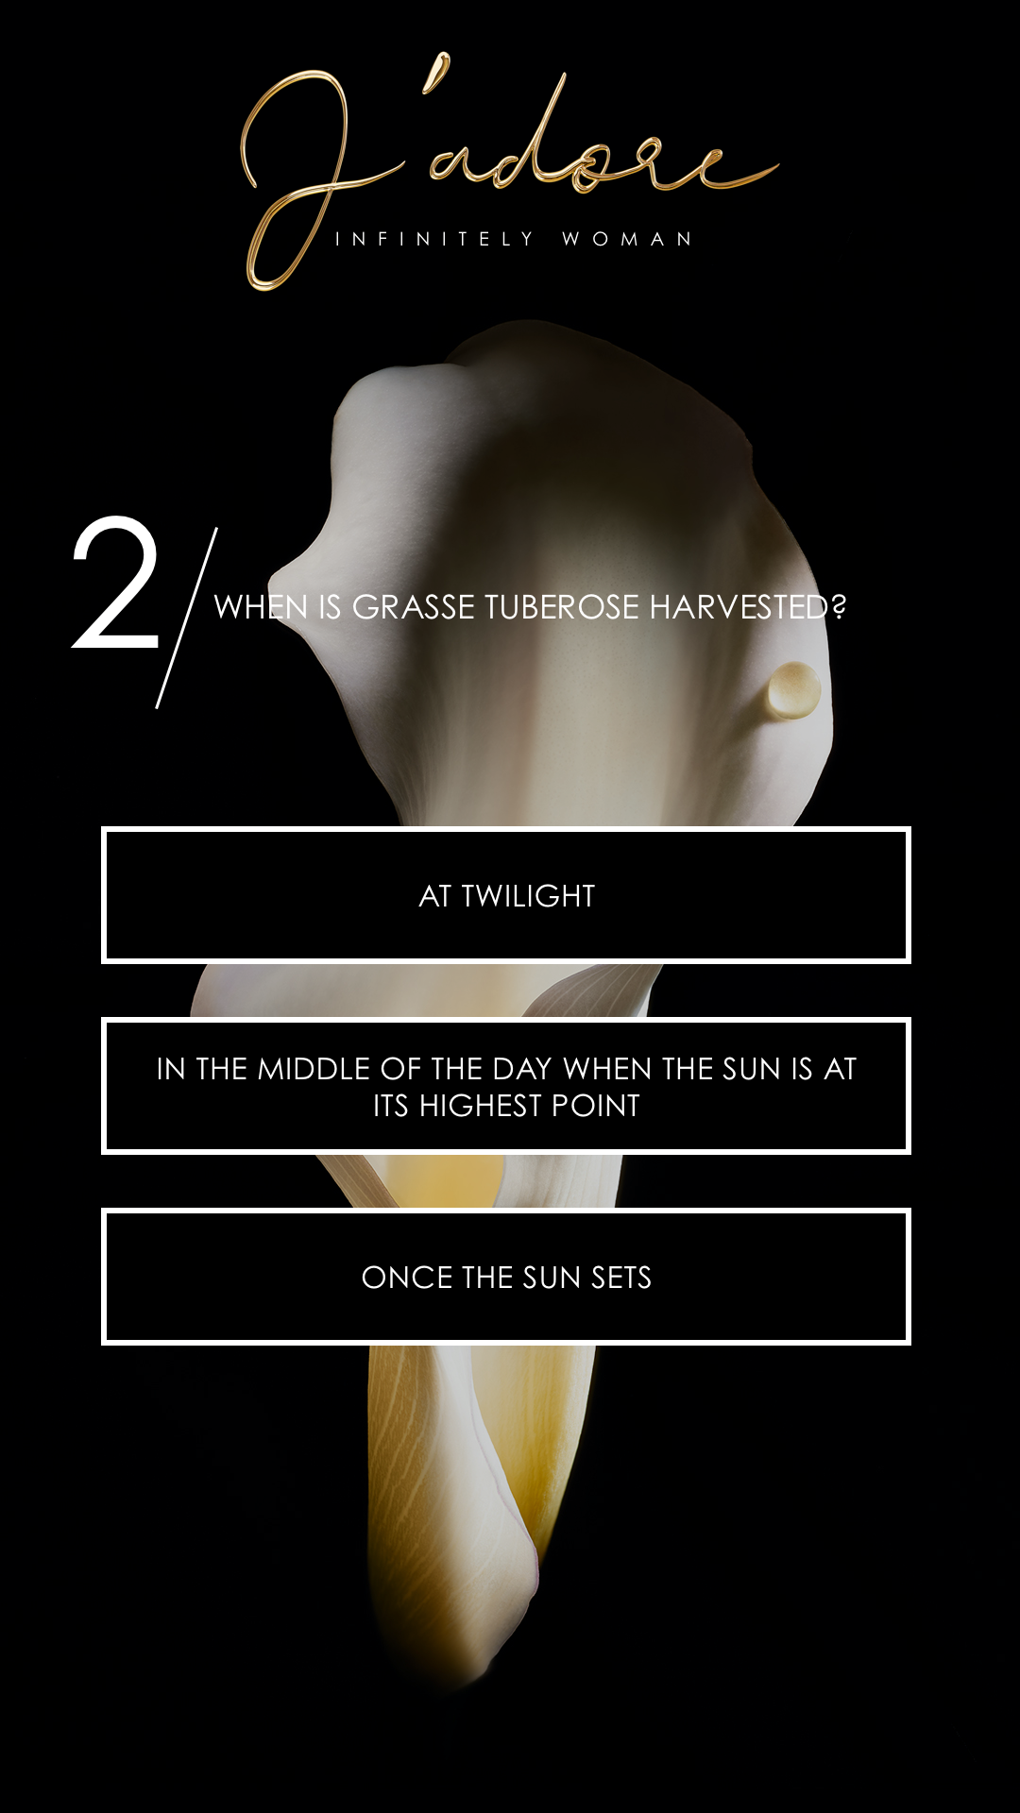
Delete logo
Replace background with https://www.dropbox.com/s/c4srix9r06to0pu/Background%202.jpeg?dl=0
Replace Question with:
Where do you usually buy your fragrance from?
Replace Answer with:
In-Store
Replace Answer with:
Online
Replace Answer with:
Both

Slide 5
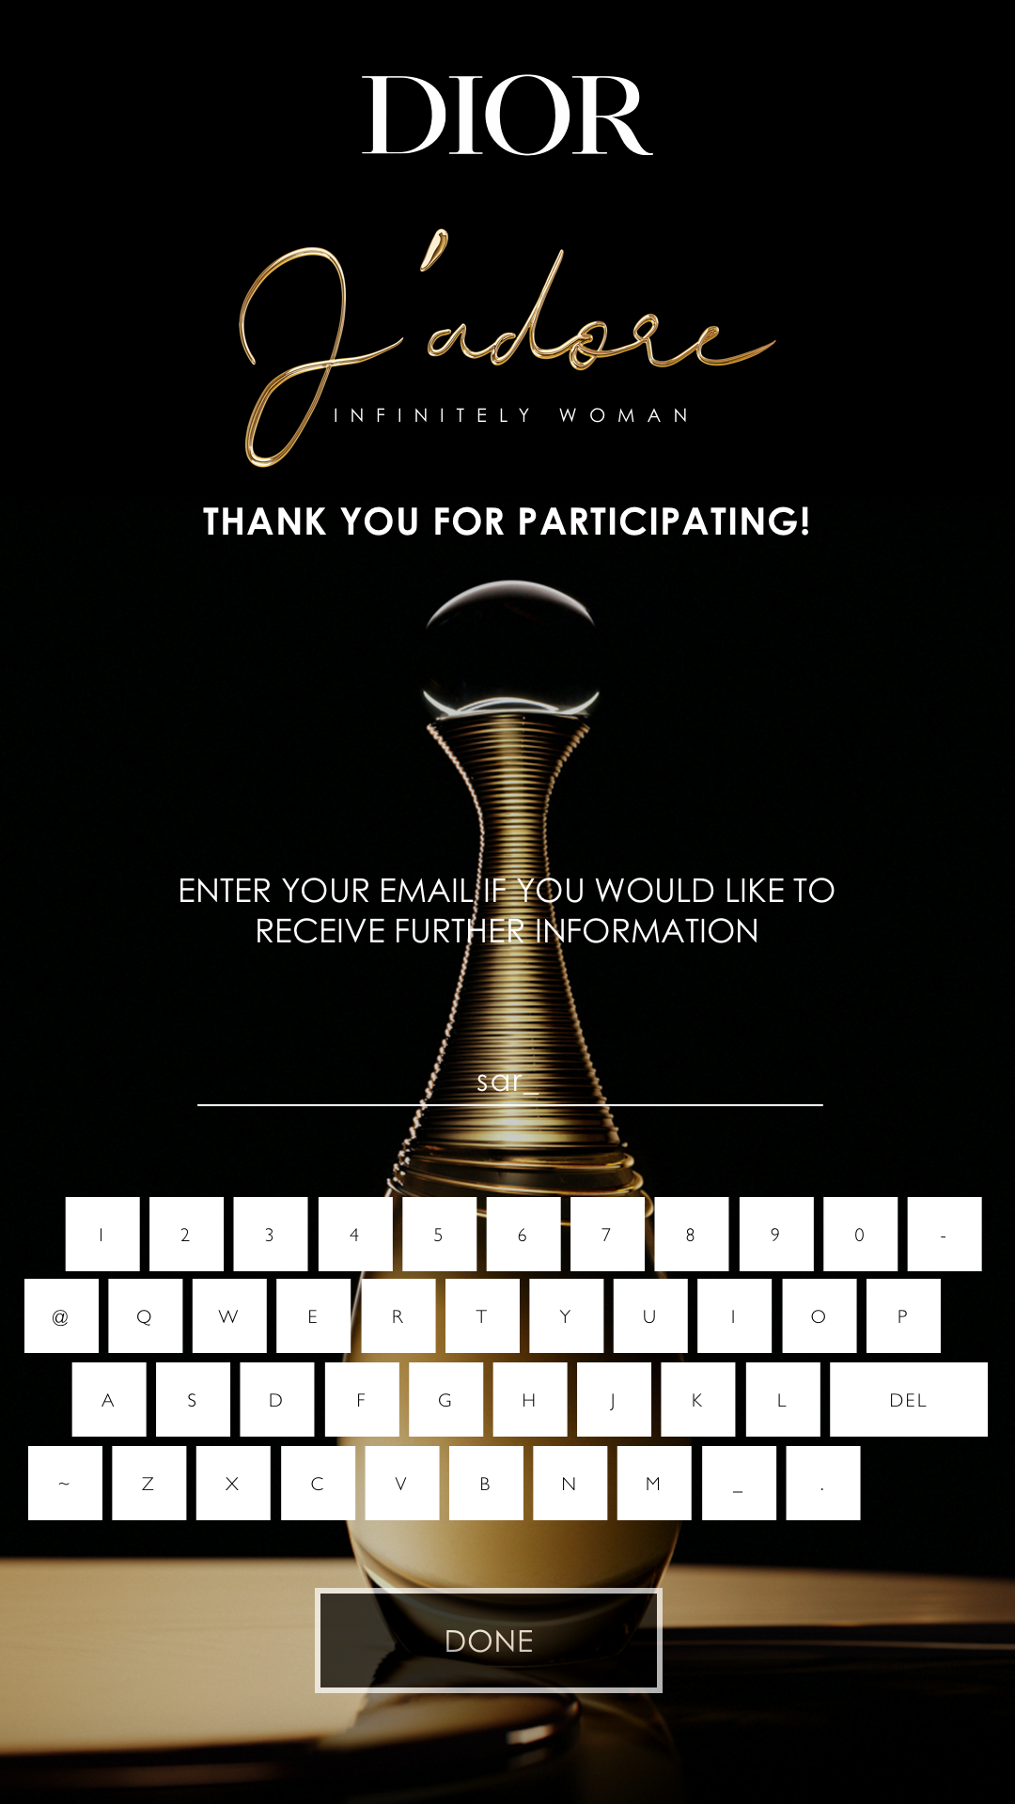
Delete logo
Replace background with https://www.dropbox.com/s/c4srix9r06to0pu/Background%202.jpeg?dl=0

Slide 6

Delete logo
Replace background with https://www.dropbox.com/s/c4srix9r06to0pu/Background%202.jpeg?dl=0

